Slide 1
PROJECT TITLE - SECURE DATA HIDING IN IMAGES USING STEGANOGRAPHY
CAPSTONE PROJECT
Presented By: Pagidi Sahithi
Student Name : Pagidi Sahithi
College Name : Malla Reddy Engineering College For Women Department : CSE-Cyber Security

Slide 2
OUTLINE
Problem Statement
Technology used
Wow factor
End users
Result
Conclusion
Git-hub Link
Future scope

Slide 3
Problem Statement
The project aims to develop a steganography system that embeds secret messages within digital media files, such as images or audio, ensuring the hidden information remains undetectable to casual observers. The focus is on creating an algorithm that balances invisibility of the message with data integrity. The system will support both encoding and decoding processes efficiently. Key challenges include maintaining quality of the cover media while embedding data and ensuring robustness against detection or tampering. The project also explores he use of modern cryptographic techniques to enhance security.

Slide 4
Technology used
Software requirements:
Operating system – Windows
Coding language – Python
Libraries – cv2(opencv)
Hardware requirements
Processor – i5
RAM – 4GB
Key Board – Standard Windows Keyword
Mouse – Two or three button mouse

Slide 5
Wow factors
This steganography project leverages Python and the OpenCV module to securely hide and extract messages within images, combining encryption and decryption techniques. By utilizing OpenCV for image manipulation, it ensures the seamless embedding of data, making the hidden message nearly undetectable to the human eye. The encryption process adds an extra layer of security, protecting the message from unauthorized access. The integration of these technologies provides a robust solution for digital communication, ensuring privacy and confidentiality. This project demonstrates the power of Python in digital security through innovative use of image processing and cryptography.

Slide 6
End users
Security Professionals: To protect sensitive data by embedding it in innocuous files, preventing
unauthorized access or detection.
Cybercriminals: Often use steganography to hide malicious code or illegal communication within seemingly
harmless files, like images or videos, to avoid detection by security systems.
Journalists & Whistleblowers: To communicate confidential information securely, especially when they want
to protect their sources or prevent government surveillance.
Digital Forensics Experts: Use steganography detection tools to uncover hidden data in digital investigations,
especially when tracking down cybercrimes.
Privacy-Conscious Individuals: People who value privacy may use steganography to securely share personal
or sensitive information without attracting unwanted attention.

Slide 7
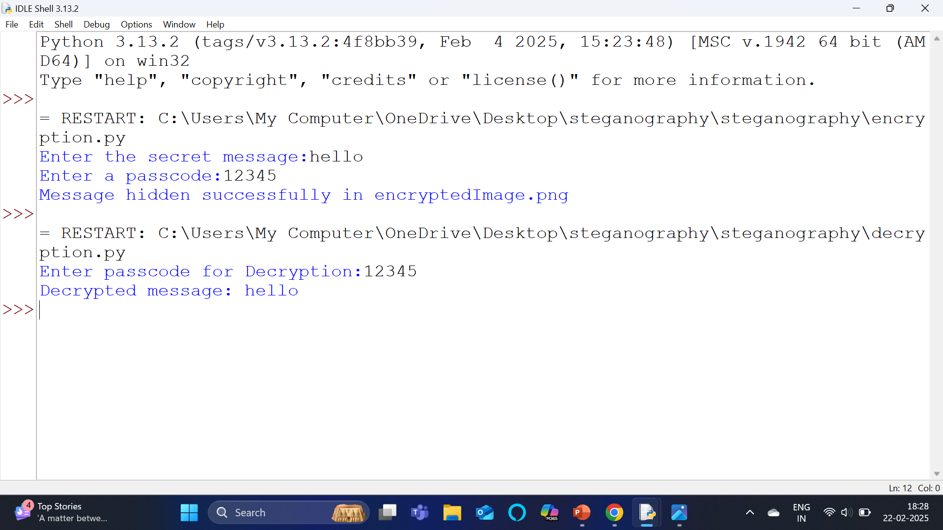
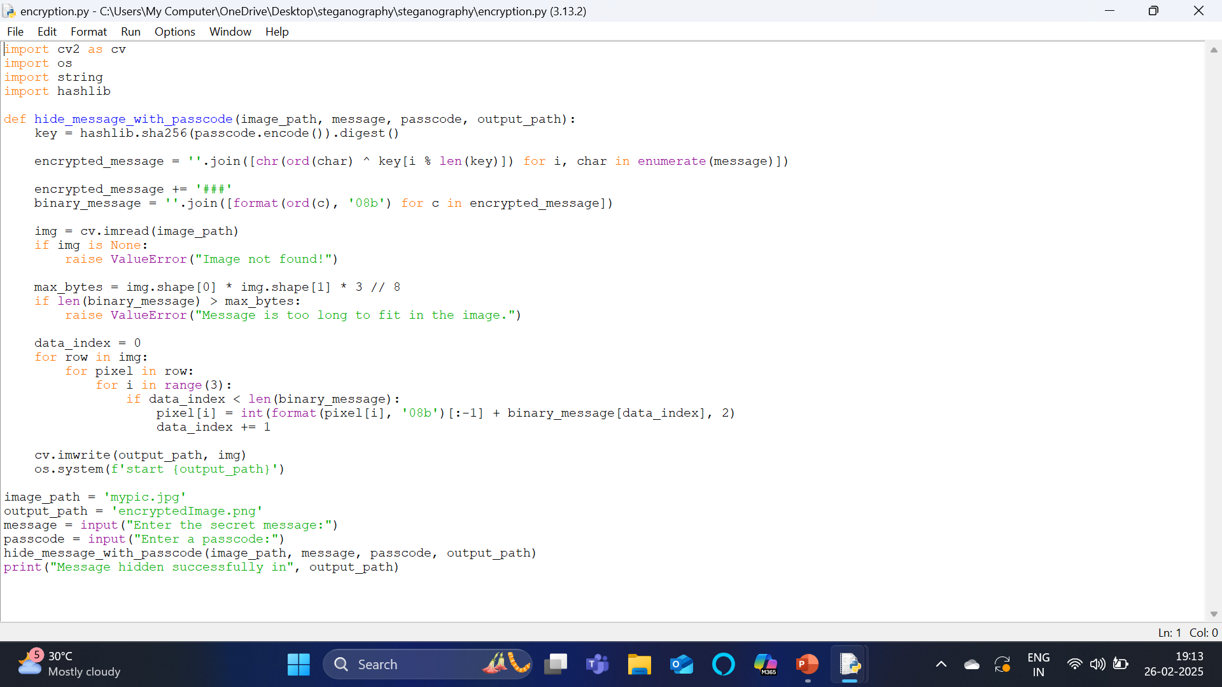
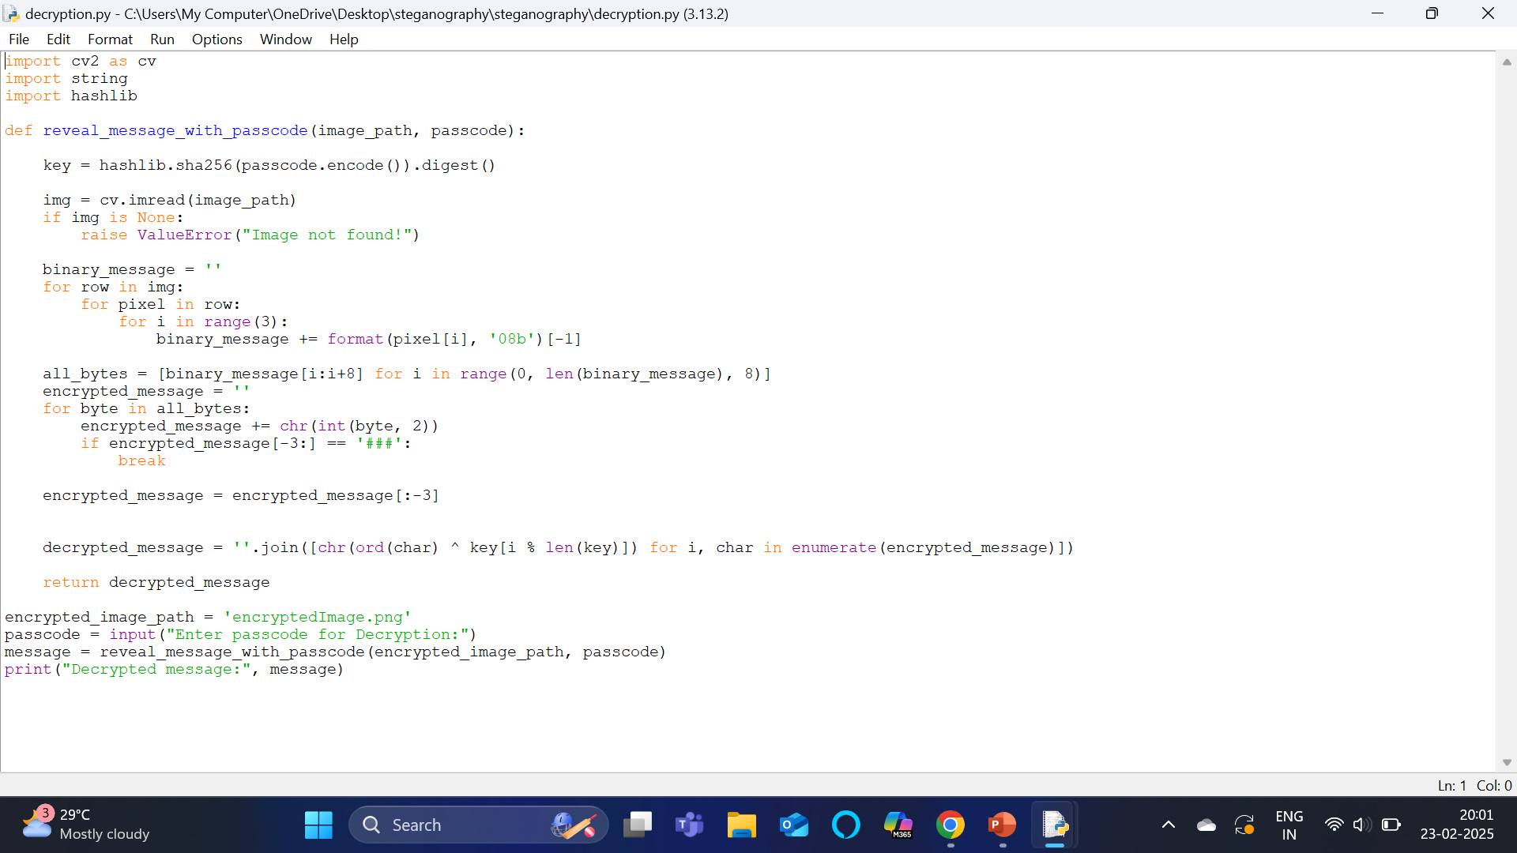

Results
Output
Encryption code Decryption code

Slide 8
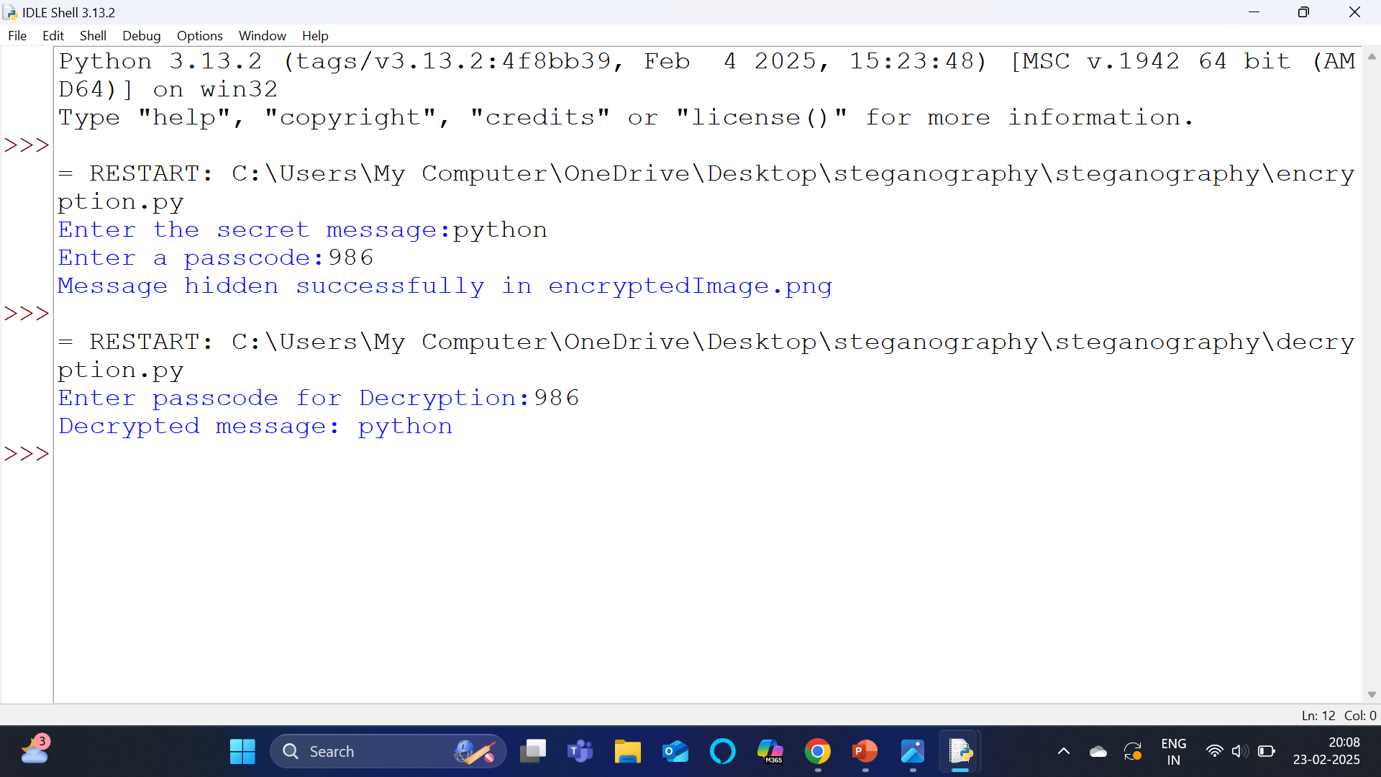
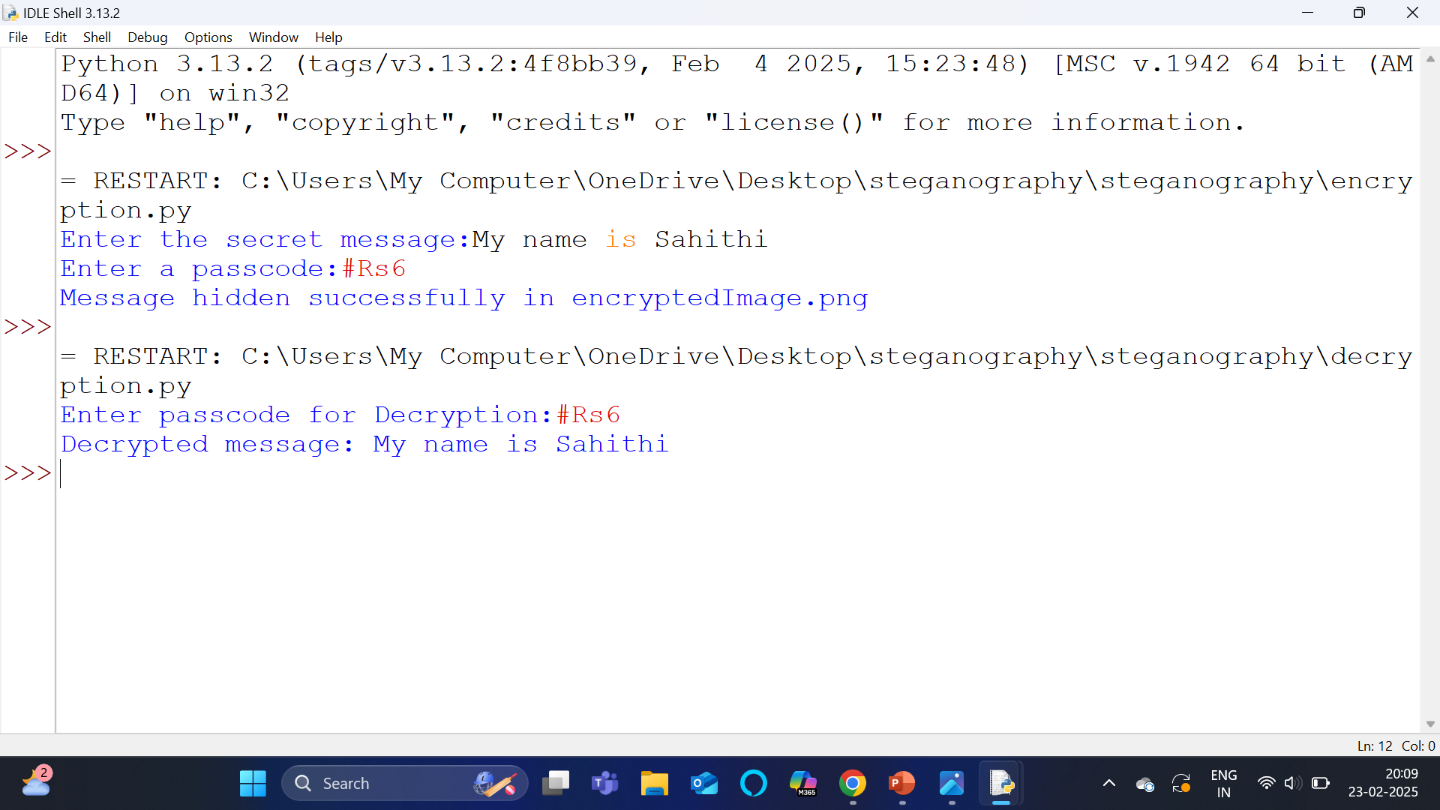
Results
Screenshot-2
Screenshot-3

Slide 9
Conclusion
In conclusion, this steganography project effectively demonstrates how digital messages can be securely hidden within images using Python and the OpenCV library. By embedding the message in the least significant bits of an image, it ensures minimal alteration to the image's visual quality while keeping the hidden data intact. The encryption and decryption techniques further enhance security, providing a private means of communication. This project showcases the potential of steganography in protecting sensitive information in a digital world. It emphasizes the importance of image processing and cryptographic techniques in safeguarding privacy.

Slide 10
GitHub Link
https://github.com/Sahithi200610/steganography.git

Slide 11
Future scope(optional)
The future scope of steganography includes enhanced security for communications, integrating with blockchain for private transactions. AI and machine learning will improve both data hiding and detection methods. It will play a key role in digital media watermarking and copyright protection. Privacy and anti-surveillance tools will increasingly rely on steganography for secure information exchange. Additionally, it will secure communication
in IoT devices and help prevent deepfake manipulation by embedding hidden data.

Slide 12
THANK YOU

